Slide 1

Predicting Stroke Using Patient Characteristics
Ori Rinaman
Bellevue University

Slide 2

Business Problem and Background History

Slide 3
Data Explanation
Id: Unique identifier of each patient.
Gender: Categorical, the gender of the patient.
Age: Numeric, the age of the patient.
Hypertension: Boolean, 0 if the patient does not have hypertension and 1 if the patient has hypertension.
Heart Disease: Boolean, 0 is the patient does not have heart disease, 1 if the patient has heart disease.
Ever Married: Boolean, “No” if the patient has never been married, “Yes” is the patient is/has been married.
Residence Type: Categorical, if the resident lives in a Rural or Urban home.
Average Glucose Level: Numeric, the average glucose level in the patient’s blood.
BMI: Numeric, the body mass index of the patient.
Smoking Status: Categorical, if the patient “formerly smoked”, “never smoked”, “smokes”, or “unknown”.
Stroke: Boolean, 1 if the patient had a stroke, 0 if the patient did not have a stroke.

Slide 4
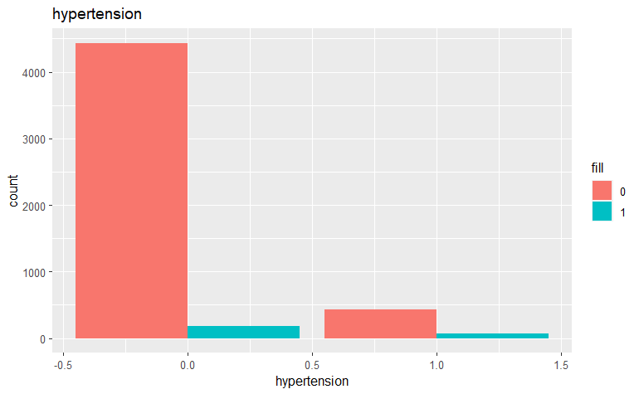
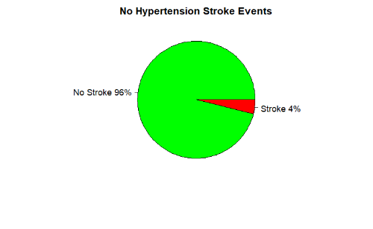
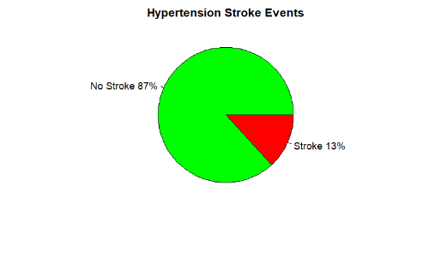
Methods and Analysis (Hypertension)
2-Proportions Test p-value: 0.00

Slide 5
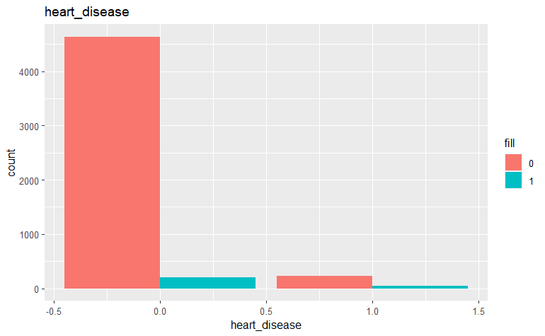
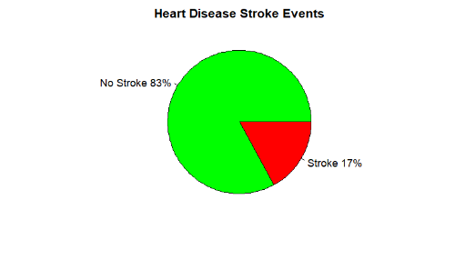
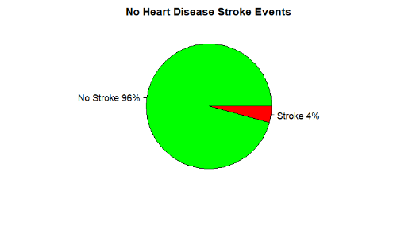
Methods and Analysis (Heart Disease)
2-Proportions Test p-value: 0.00

Slide 6
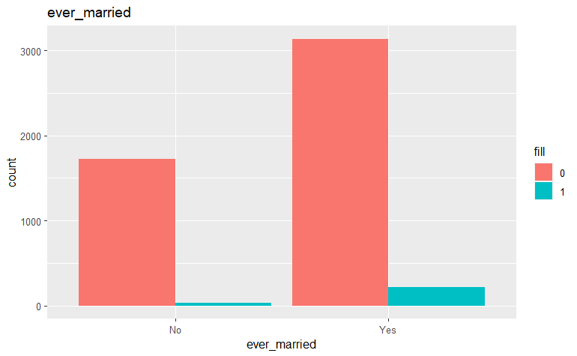
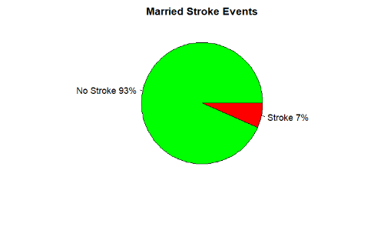
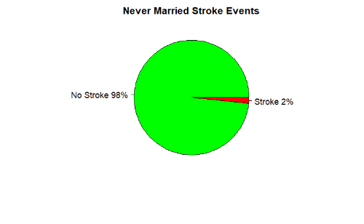
Methods and Analysis (Ever Married)
2-Proportions Test p-value: 0.00

Slide 7
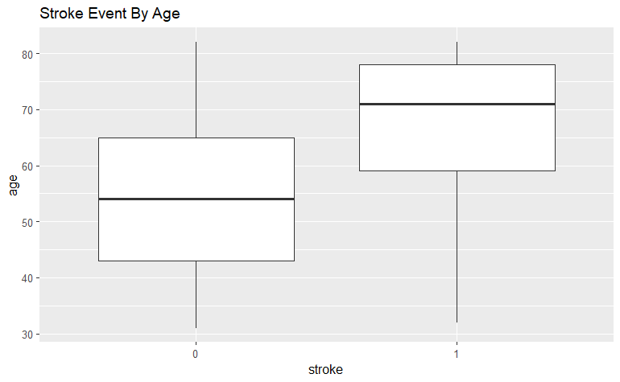
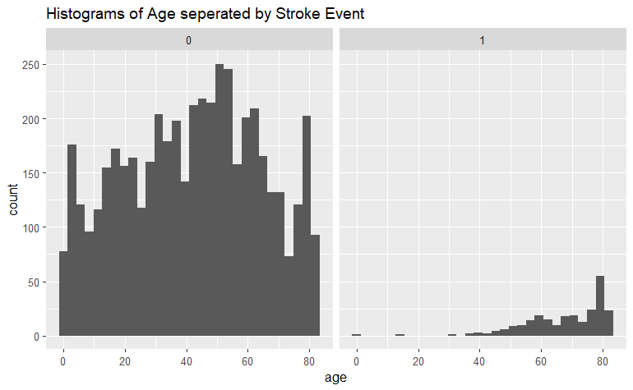
Methods and Analysis (Age)

Slide 8
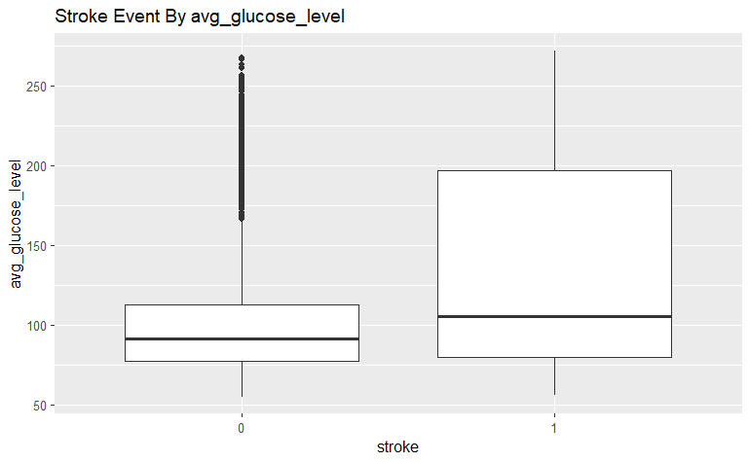
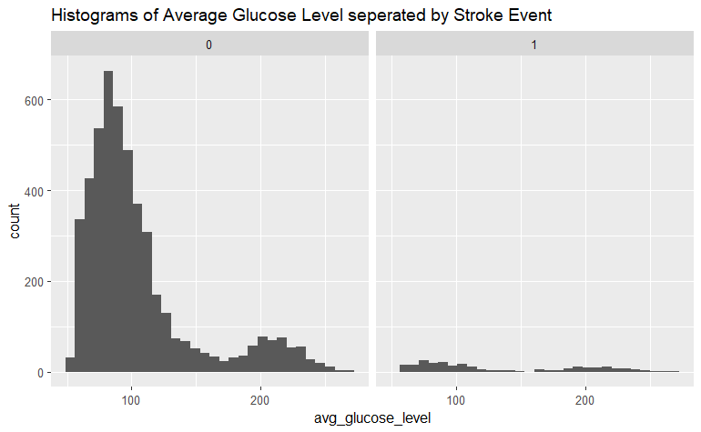
Methods and Analysis (Average Glucose Level)

Slide 9
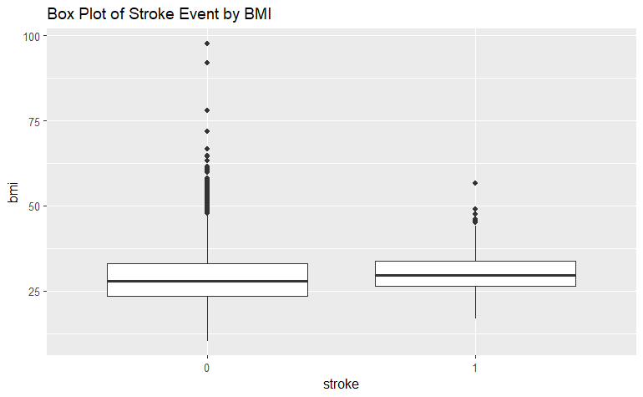
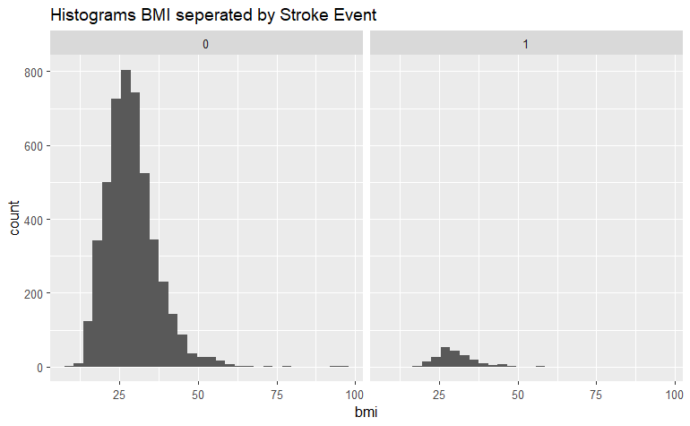
Methods and Analysis (BMI)

Slide 10
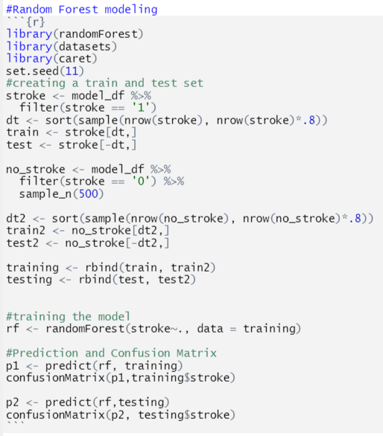
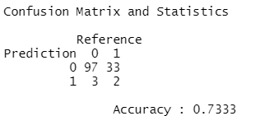
Random Forest Model

Slide 11
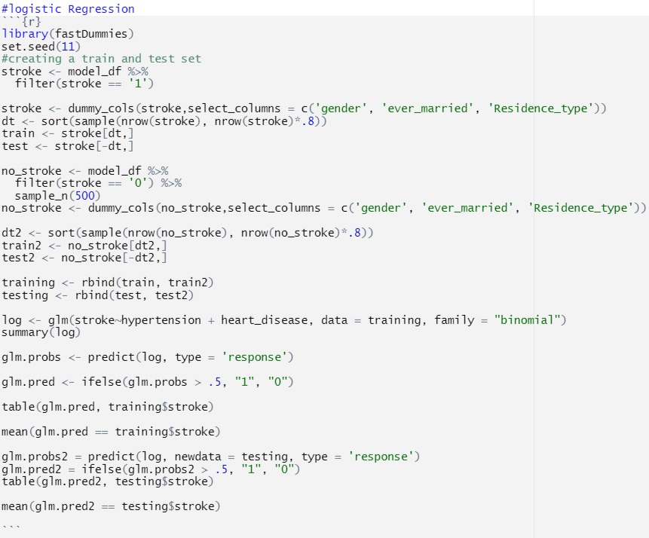
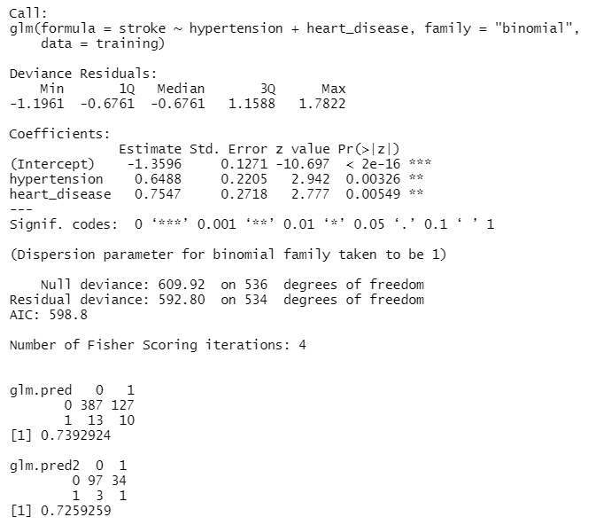
Logistic Regression Model

Slide 12


Slide 13
Conclusion

